Slide 1
UT Results
CampManager
MEINF UDL – EPS 2022-2023
Notes:
Joel Aumedes

Slide 2
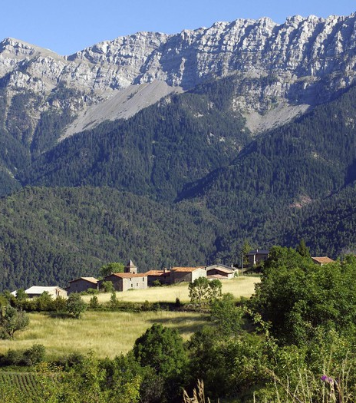
Table Of Contents
Executive Summary
Methodology
Metrics
Results Analysis
Global Analysis
By Task Analysis
Proposed Recommendations
Notes:
Joel Aumedes

Slide 3
Executive Summary
Semi Formal Test
Effectiveness
Efficiency
User Satisfaction
3 tasks
Create Campaign Table From Organisation Page
Validate If The Table Is Created And Its Status
Add New Organisation In Space While In Another Organisation’s Space
Methodology
Video And Audio Recording
Eye-Tracking
Retrospective Thinking-Aloud
Notes:
Joel Aumedes

Slide 4

SUS Average Score
63.5
Notes:
Joel Aumedes

Slide 5
Executive Summary: Results
Task 1
Completed successfully by 3/4 of users.
Confusion and errors due to large number of nested pages.
Proposed Solution: Renaming some links and adding buttons.
Task 2
Completed successfully by 4/4 users.
Proposed Upgrade: Customized message or loading bar.
Task 3
Completed successfully by 2/4 of users.
Proposed Solution: Enlarging footer and adding text.
Footer buttons are too small.
Notes:
Joel Aumedes

Slide 6
Methodology
The Test was carried out in the UsabiliLAB of the EPS.
Each session took around 35 minutes.
Welcoming
Pre-Test
Task
Post-Task
Post-Test
Notes:
Joel Aumedes

Slide 7
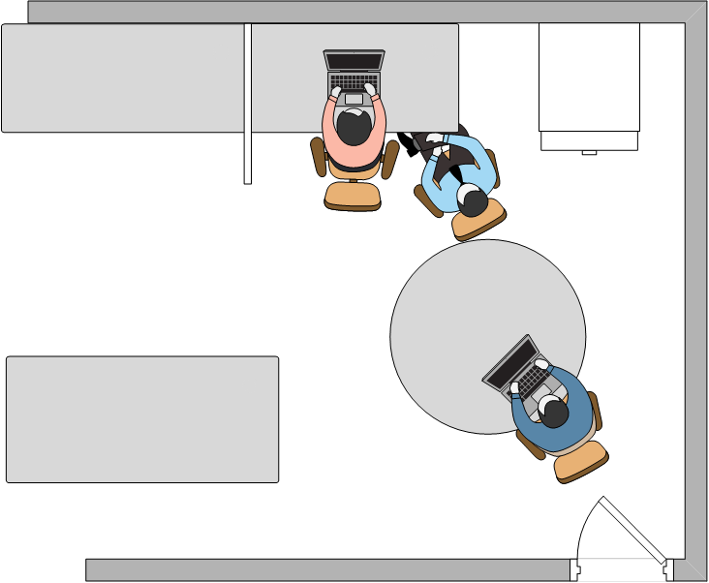
Tools And Equipment
Notes:
Joel Aumedes

Slide 8
Tools And Equipment
Moderator
Moderator Script
Pen
Informed Consent Forms
Notes:
Joel Aumedes

Slide 9
Tools And Equipment
Test User
Computer With The App
Tobii Studio
Tobii Eye-Tracker
Camera And Microphone
Notes:
Joel Aumedes

Slide 10
Tools And Equipment
Observer
Note Taking App
Application Logs
Notes:
Joel Aumedes

Slide 11

Metrics
Efectiveness
Efficiency
Engaging
Percentage Of Tasks Completed Correctly
Task Success Rate
Time Required For Each Task
Number Of Errors Made During Task Completion
Number Of Positive/Negative Expressions During Task Completion
System Usability Scale (SUS)
Notes:
Alejandro Clavera

Slide 12
Eye-Tracking Metrics
Time To First Fixation
Total Time Of Fixation
Mouse Clicks
Notes:
Alejandro Clavera

Slide 13
Results
Effectiveness
Task | Task Success Rate
Task 1 | 0.75 (3/4)
Task 2 | 1.00 (4/4)
Task 3 | 0.50 (2/4)
Percentage Of Tasks Completed Correctly | 33%
Notes:
Alejandro Clavera

Slide 14
Results
Efficiency
Participant | Task 1 Duration (s) | Task 2 Duration (s) | Task 3 Duration (s)
User 1 | Not finished | 80 | Not finished
User 2 | 285 | 83 | 85
User 3 | 213 | 25 | 87
User 4 | 190 | 36 | Not finished
Mean | 229.33 | 56 | 86
Standard Deviation | 49.56 | 29.81 | 1.41
Notes:
Alejandro Clavera

Slide 15
Results
Efficiency – Time To First Fixation
 | Task 1 |  | Task 2 | Task 3
 | Going To Tables List | Add Table | Status Message | Navbar Top | Navbar Bottom | Change Organisation
Mean | 2.46 | 3.90 | 0.32 | 42.20 | 29.87 | 0.97
Standard Deviation | 3.34 | 0.32 | 0.39 | 24.55 | 9.29 | 0.79
Notes:
Alejandro Clavera

Slide 16

Results
Efficiency – Number Of Errors
Notes:
Alejandro Clavera

Slide 17

Results
Engaging
Participant | Q01 | Q02 | Q03 | Q04 | Q05 | Q06 | Q07 | Q08 | Q09 | Q10 | SUS Score
User 1 | 4 | 2 | 5 | 3 | 3 | 3 | 4 | 3 | 3 | 4 | 60
User 2 | 5 | 5 | 5 | 1 | 5 | 5 | 5 | 1 | 5 | 5 | 70
User 3 | 4 | 2 | 4 | 1 | 4 | 2 | 3 | 2 | 4 | 5 | 67.5
User 4 | 3 | 3 | 3 | 1 | 3 | 2 | 3 | 3 | 3 | 3 | 57.5
Mean | 4 | 3 | 4.25 | 1.5 | 3.75 | 3 | 3.75 | 2.25 | 3.75 | 4.25 | 63.75
Std. Dev. | 0.82 | 1.41 | 0.96 | 1 | 0.96 | 1.41 | 0.96 | 0.96 | 0.96 | 0.96 | 5.95
Notes:
Alejandro Clavera

Slide 18
Task 1
Task Success Rate | 0.75 (3/4)
Participant | Task Duration (s)
User 1 | Not finished
User 2 | 285
User 3 | 213
User 4 | 190
Mean | 229.33
Standard Deviation | 49.56
Notes:
Jordi Lazo

Slide 19
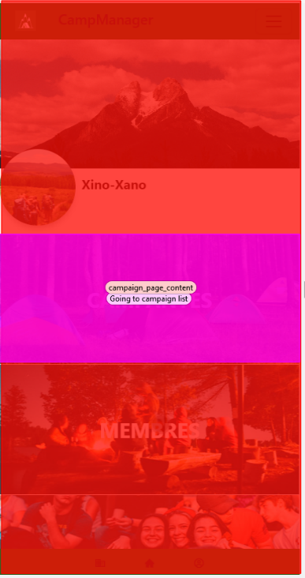
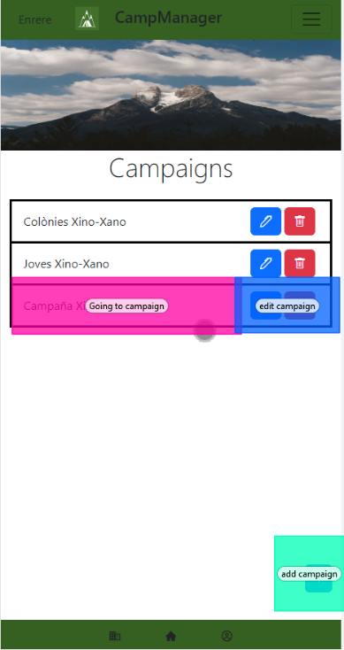
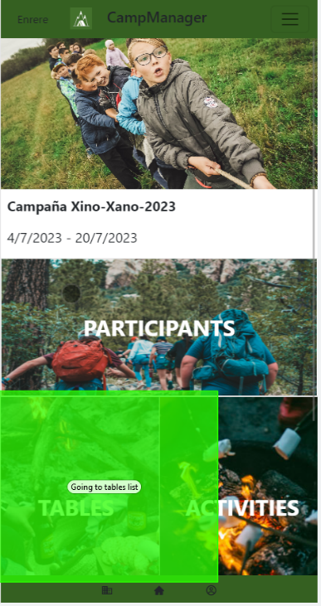
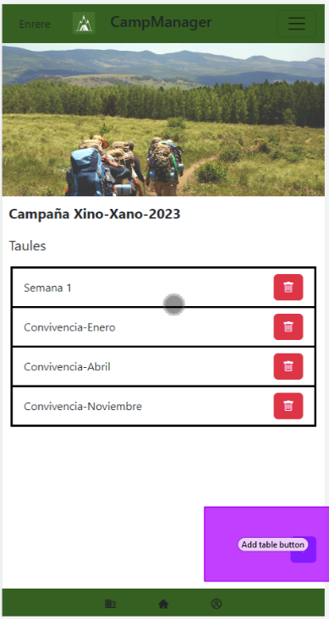
Task 1
Areas Of Interest
Going To Tables List
Add Table Button
Going To Campaign List
Going To Campaign
Notes:
Jordi Lazo

Slide 20
Task 1
Some concepts used are not common within the field, which caused confusion
Not an easy task to complete
The Campaign Name is not clearly clickable
User Experience
Notes:
Jordi Lazo

Slide 21
Task 2
Task Success Rate | 1.00 (4/4)
Participant | Task Duration (s)
User 1 | 80
User 2 | 83
User 3 | 25
User 4 | 36
Mean | 56
Standard Deviation | 29.81
Notes:
Jordi Lazo

Slide 22
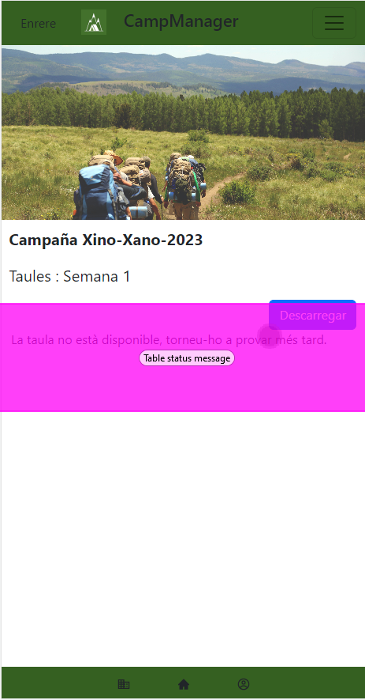
Task 2
Area Of Interest
Notes:
Jordi Lazo

Slide 23
Task 2
User not knowing if the table was unavailable because of a system error
Message Not Clear
Task completed by all users, but message not effective
User Experience
Notes:
Jordi Lazo

Slide 24
Task 3
Task Success Rate | 0.50 (2/4)
Participant | Task Duration (s)
User 1 | Not finished
User 2 | 85
User 3 | 87
User 4 | Not finished
Mean | 86
Standard Deviation | 1.41
Notes:
Jordi Lazo

Slide 25
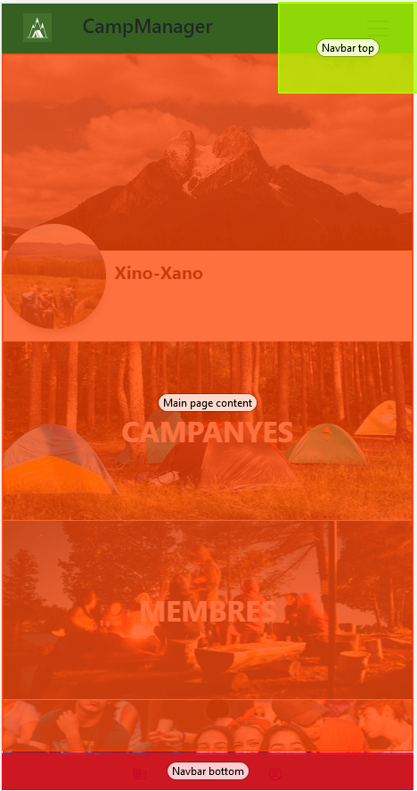
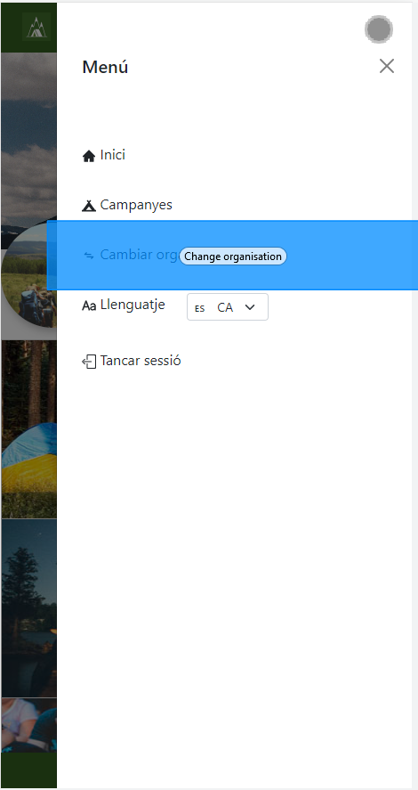
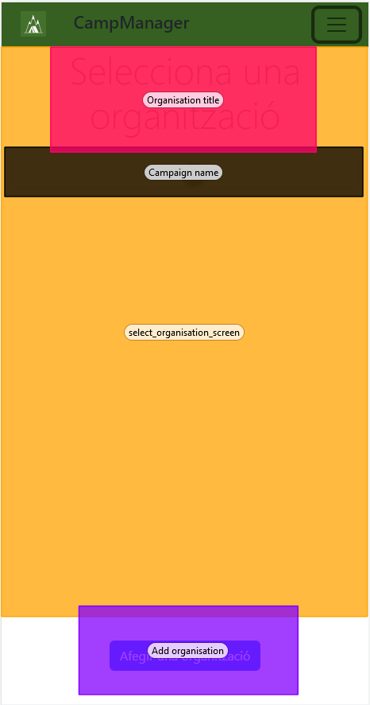
Task 3
Areas Of Interest
Campaign Page
Change Organisation
Add Organisation
Notes:
Jordi Lazo

Slide 26
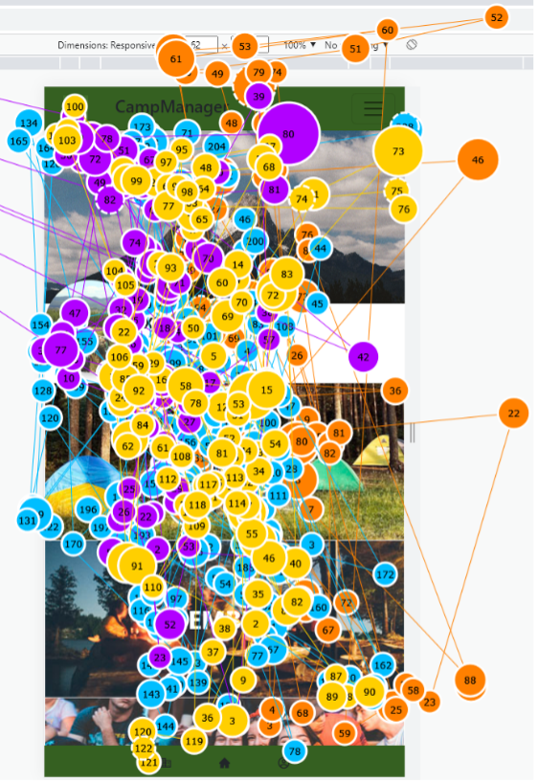
Task 3
Gazeplot
Notes:
Jordi Lazo

Slide 27
Task 3
Users focus their attention on the central part of the screen, missing the footer
Difficult Task
The elements required for this task are not visible enough
User Experience
Notes:
Jordi Lazo

Slide 28
Recommendations
High Priority
Change Of Organisation Button Visibility
Enter A Campaign Page Action
Medium Priority
No Table Available Status Message
Low Priority
Main Organisation Page Link Titles
Notes:
Carlos Isaac

Slide 29
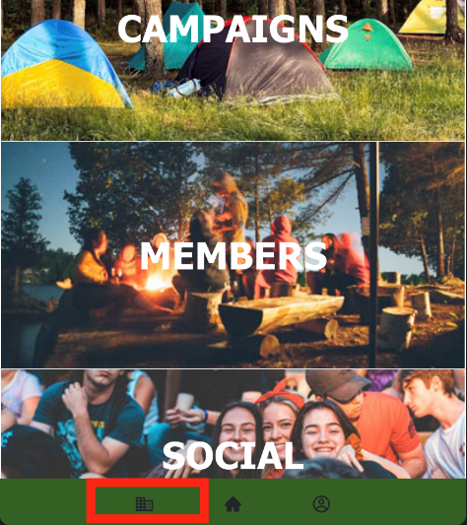
Recommendations
Change Of Organisation Button Visibility
Add text to the buttons and make them larger
Notes:
Carlos Isaac

Slide 30
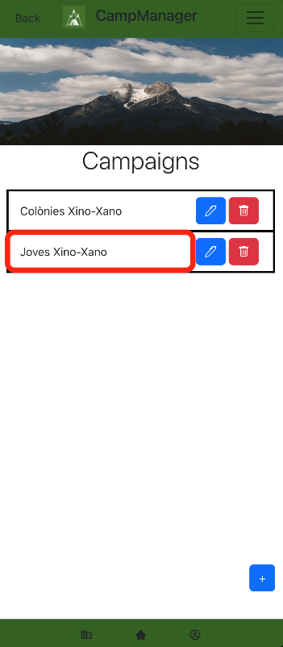
Recommendations
Enter A Campaign Page Action
Add another button alongside the existing Edit and Delete ones
Notes:
Carlos Isaac

Slide 31
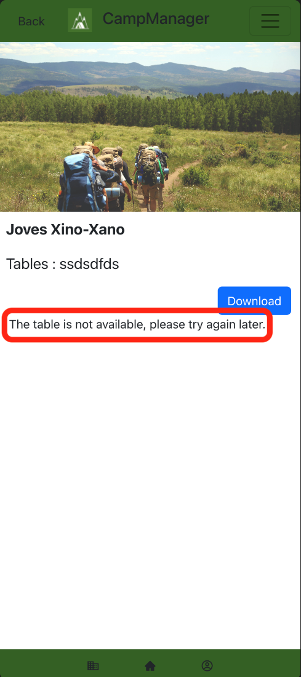
Recommendations
No Table Available Status Message
Change the message to a message that reports the real and current situation of the table generation
Notes:
Carlos Isaac

Slide 32
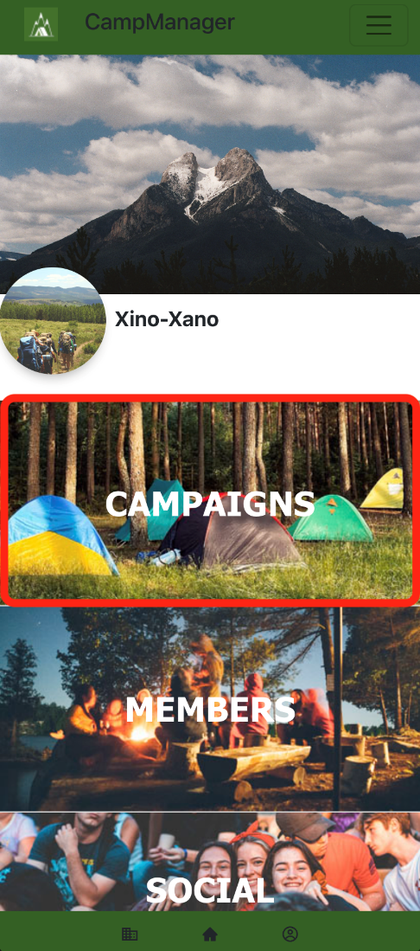
Recommendations
Main Organisation Page Link Titles
Change the “Campaigns” title to Camps, since it is used more in the professional environment
Notes:
Carlos Isaac

Slide 33

Thank You For Your Attention!
33
CampManager
UT Results
Notes:
Carlos Isaac

